Slide 1


Why Our
Screens
Make Us
Less Happy
——Adam Alter
Speaker : Wen Jie

Slide 2

1
INTRODUCTION
2
SUMMARY
CONTENT
3
RESPONSE
4
Q & A

Slide 3

1
INTRODUCTION

Slide 4



01
INTRODUCTION
Adam Alter
Professor of Marketing at New York University’s Stern School of Business
the New York Times
bestselling author of two books
M.A. & Ph.D. (Psychology)
Princeton University
BS.Sc (Psychology)
University of New South Wales

Slide 5
2
SUMMARY

Slide 6
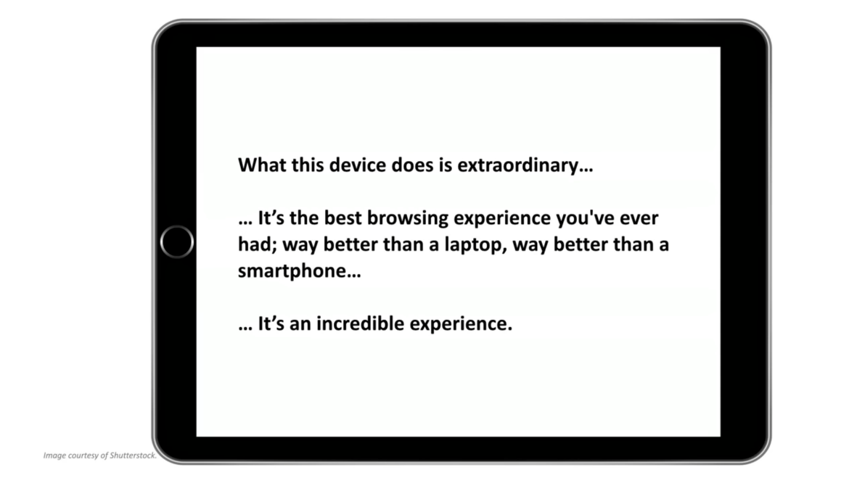
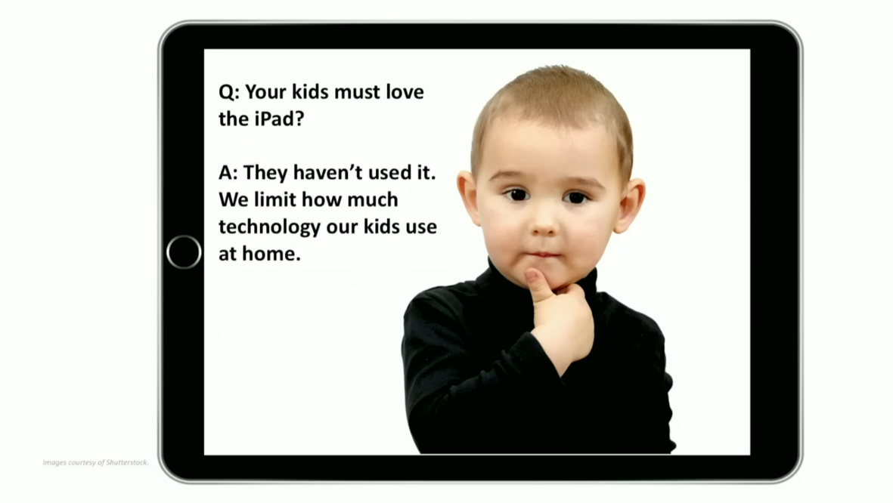
02
SUMMARY
Steve Jobs
"dogfooding"
In the business world
exception
use their own products
to demonstrate their confidence

Slide 7
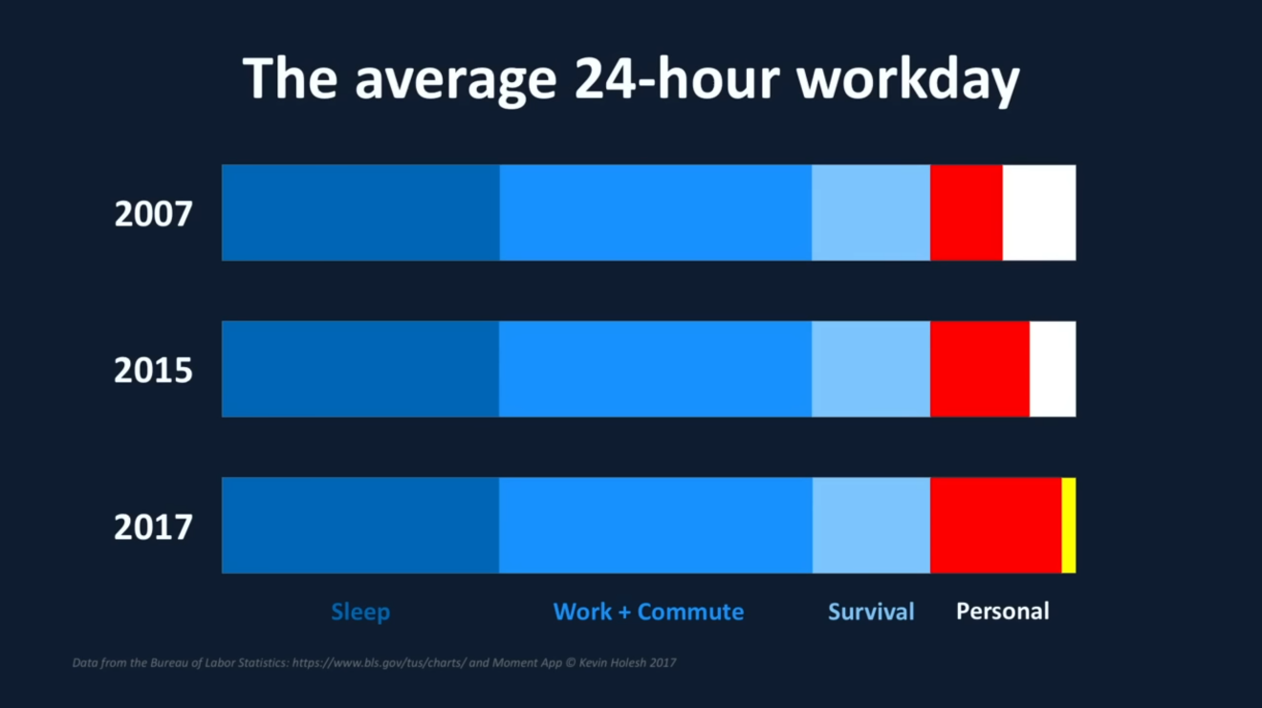
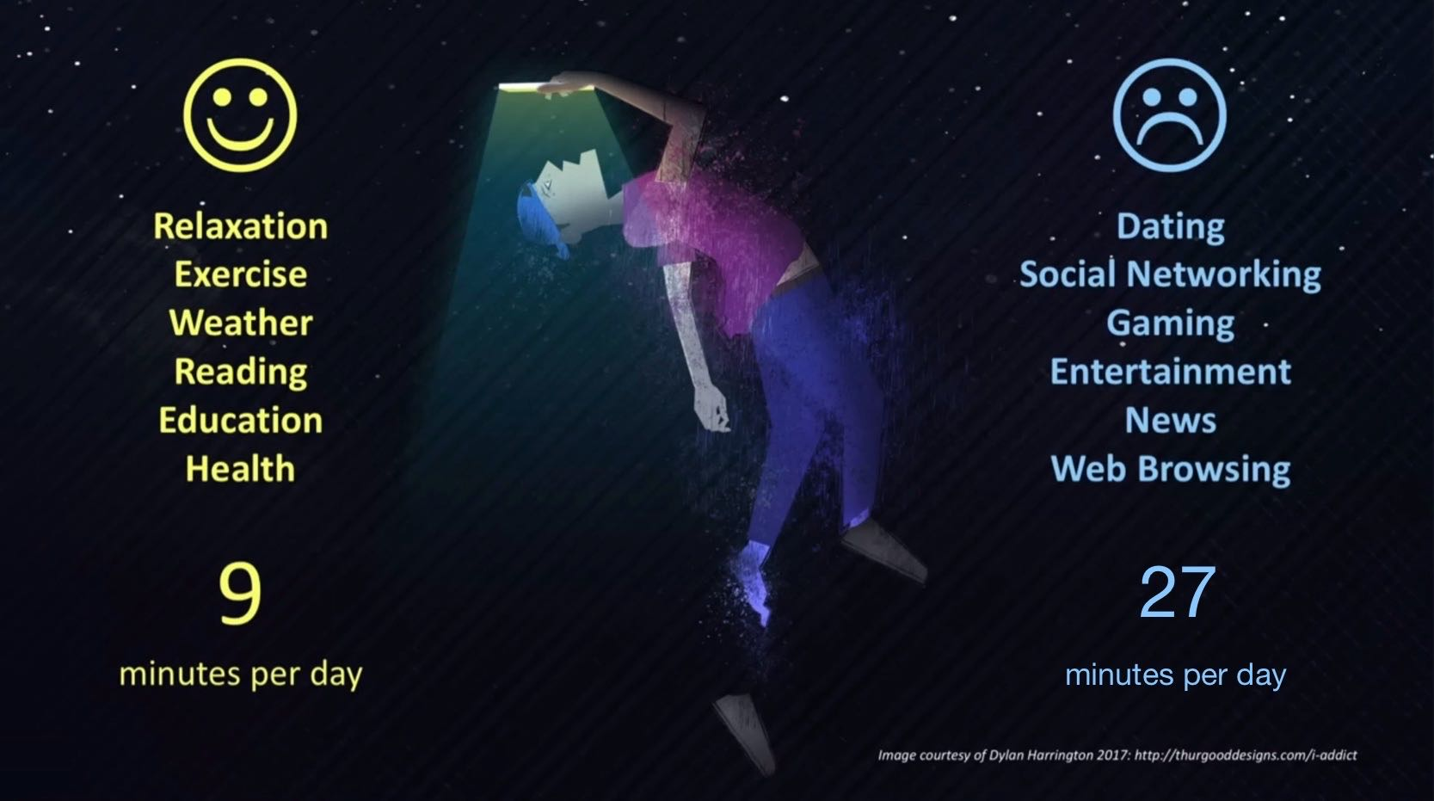
02
SUMMARY
encroaches on
people’s
personal time
Allocating a significant amount of time
on unpleasant apps.

Slide 8

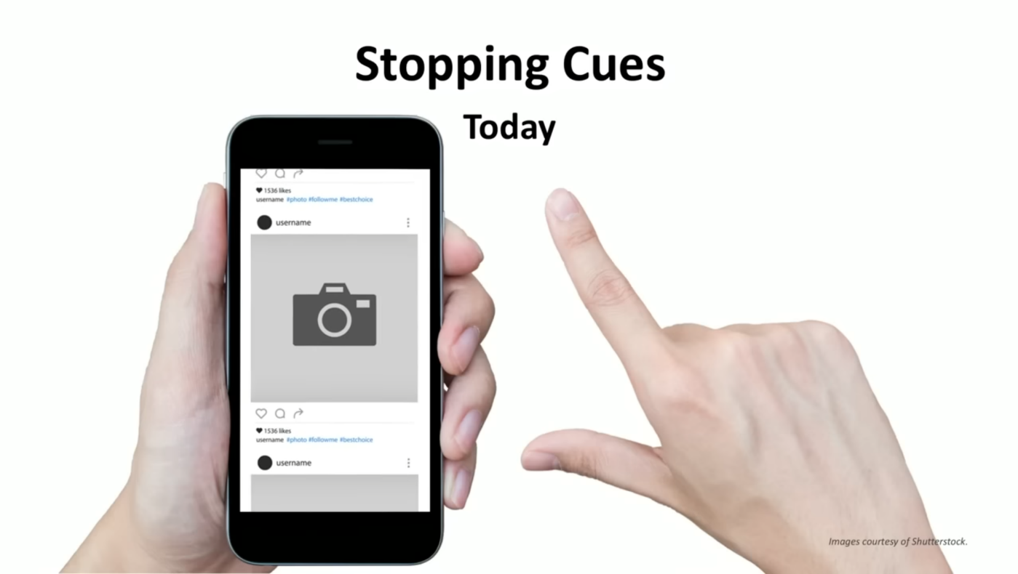
02
SUMMARY
the absence of stopping cues

Slide 9
02
SUMMARY
personal strategies
(creating rules,
getting used to them,
expand them)
disconnect from screens
experience
a richer life

Slide 10
3
RESPONSE

Slide 11
03
RESPONSE
level-view
perspective

Slide 12
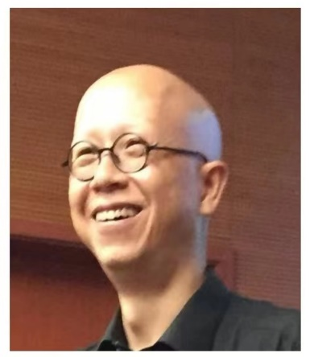
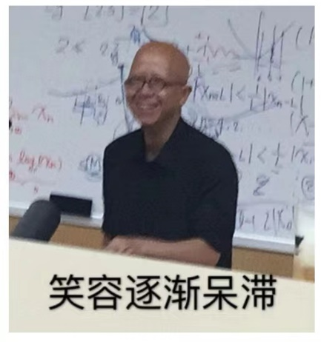
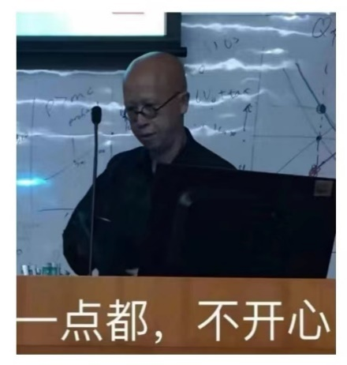

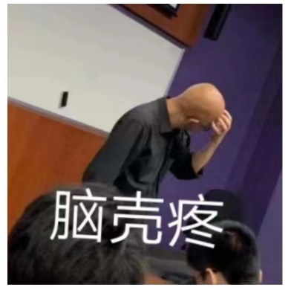


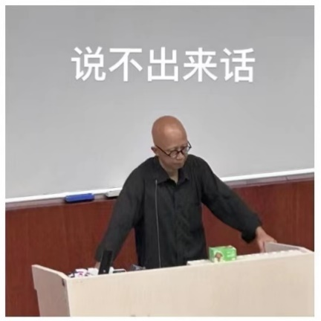
03
RESPONSE
"novelty-boredom-regret" circle

Slide 13







03
RESPONSE
TOOLS!

Slide 14
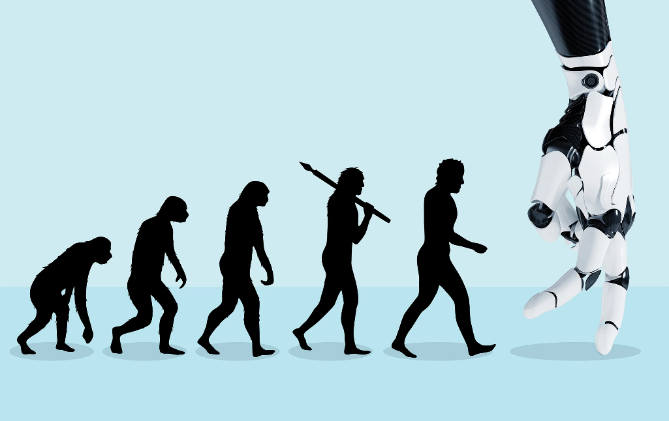


03
RESPONSE
A more
macroscopic
perspective

Slide 15
THANK YOU
FOR YOUR WATCHING

Slide 16
4
Q & A

